Slide 1
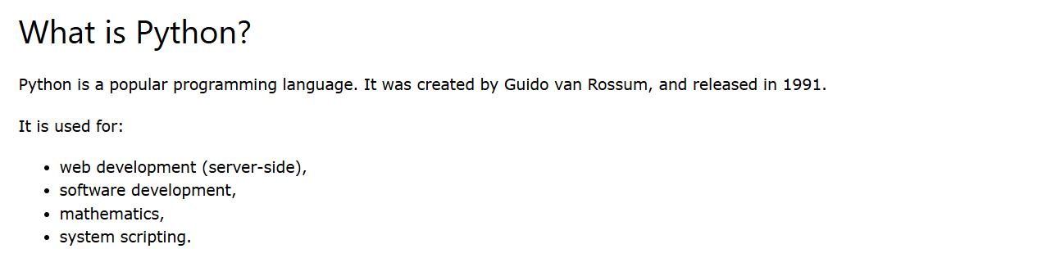
Module -1

Slide 2
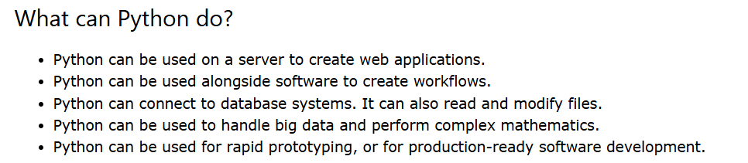

Slide 3
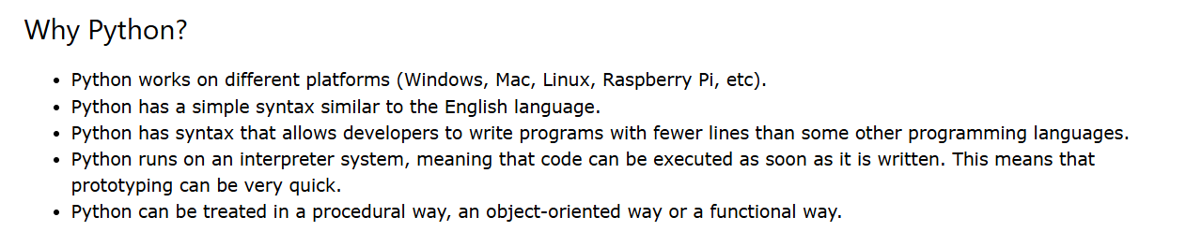

Slide 4
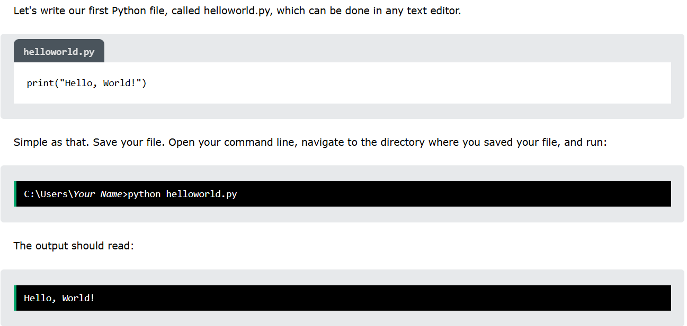
To check python:
Type in command prompt: python –version

Slide 5
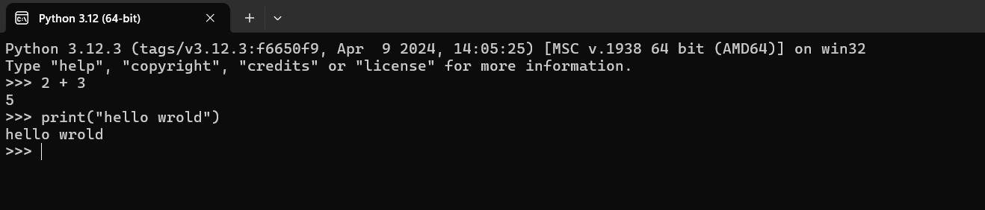
Execute python syntax:
Type python in search box: open python editor

Slide 6
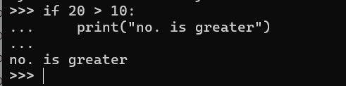
python indentation:

Slide 7

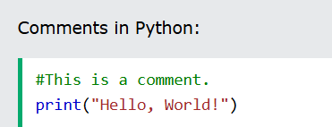
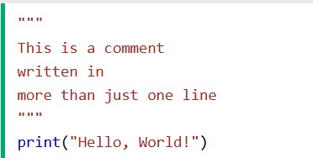

python variables and Comments:
In Python, variables are created when you assign a value to it:

Slide 8
Input Output Methods in Python

Slide 9
1. How to Input a Single String

Slide 10
1. How to Input a Single String
str1=input()

Slide 11
1. How to Input a Single String
str1=input()
Note : In online coding tests, do not type any statement inside input() function

Slide 12
2. How to Input a Single Integer

Slide 13
2. How to Input a Single Integer
n=int(input())

Slide 14
2. How to Input a Single Integer
n=int(input())
Note : By default, input() function takes string values.

Slide 15
2. How to Input a Single Integer
n=int(input())
Note : By default, input() function takes string values.
Use int() function to convert string into an integer.

Slide 16
3. How to Input a Single Float Value

Slide 17
3. How to Input a Single Float Value
n=float(input())

Slide 18
3. How to Input a Single Float Value
n=float(input())
Note : By default, input() function takes string values.

Slide 19
3. How to Input a Single Float Value
n=float(input())
Note : By default, input() function takes string values.
Use float() function to convert string into a float.

Slide 20
4. How to Input Multiple Strings Separated by Space

Slide 21
4. How to Input Multiple Strings Separated by Space
For Ex. : Rohit Rahul Virat Hardik

Slide 22
4. How to Input Multiple Strings Separated by Space
For Ex. : Rohit Rahul Virat Hardik
str1=input() #As of now, str1 is a single string, NOT a list

Slide 23
4. How to Input Multiple Strings Separated by Space
For Ex. : Rohit Rahul Virat Hardik
str1=input() #As of now, str1 is a single string, NOT a list
list1=str1.split() #After split(), we always get a list

Slide 24
4. How to Input Multiple Strings Separated by Space
For Ex. : Rohit Rahul Virat Hardik
str1=input() #As of now, str1 is a single string, NOT a list
list1=str1.split() #After split(), we always get a list
#Now, list1[0]=‘Rohit’

Slide 25
4. How to Input Multiple Strings Separated by Space
For Ex. : Rohit Rahul Virat Hardik
str1=input() #As of now, str1 is a single string, NOT a list
list1=str1.split() #After split(), we always get a list
#Now, list1[0]=‘Rohit’
#list1[1]=‘Rahul’ and so on.

Slide 26
5. How to Input Multiple Strings Separated by Comma

Slide 27
5. How to Input Multiple Strings Separated by Comma
For Ex. : Rohit,Rahul,Virat,Hardik

Slide 28
5. How to Input Multiple Strings Separated by Comma
For Ex. : Rohit,Rahul,Virat,Hardik
str1=input() #As of now, str1 is a single string, NOT a list

Slide 29
5. How to Input Multiple Strings Separated by Comma
For Ex. : Rohit,Rahul,Virat,Hardik
str1=input() #As of now, str1 is a single string, NOT a list
list1=str1.split(‘,’) #After split(), we always get a list

Slide 30
5. How to Input Multiple Strings Separated by Comma
For Ex. : Rohit,Rahul,Virat,Hardik
str1=input() #As of now, str1 is a single string, NOT a list
list1=str1.split(‘,’) #After split(), we always get a list
#Now, list1[0]=‘Rohit’

Slide 31
5. How to Input Multiple Strings Separated by Comma
For Ex. : Rohit,Rahul,Virat,Hardik
str1=input() #As of now, str1 is a single string, NOT a list
list1=str1.split(‘,’) #After split(), we always get a list
#Now, list1[0]=‘Rohit’
#list1[1]=‘Rahul’ and so on.

Slide 32
6. How to Input Multiple Strings One Below the Other

Slide 33
6. How to Input Multiple Strings One Below the Other
For Ex. :
Rohit
Rahul
Virat
Hardik

Slide 34
n=int(input()) #This is the number of elements

Slide 35
n=int(input()) #This is the number of elements
list1=[] #Start with an empty list

Slide 36
n=int(input()) #This is the number of elements
list1=[] #Start with an empty list
for i in range(n):
list1.append(input())

Slide 37
7. How to Input Multiple Strings Within Square Brackets Separated by Comma
For Ex. : [‘Rohit’,‘Rahul’,‘Virat’,‘Hardik’]

Slide 38
str=input()
string_list = str.strip("[]").split(',')
string_list = [s.strip() for s in string_list]
print(string_list)

Slide 39
8. How to Input Multiple Integers Separated by Space

Slide 40
8. How to Input Multiple Integers Separated by Space
For Ex. : 2 4 6 8

Slide 41
8. How to Input Multiple Integers Separated by Space
For Ex. : 2 4 6 8
str1=input() #As of now, str1 is a single string, NOT a list

Slide 42
8. How to Input Multiple Integers Separated by Space
For Ex. : 2 4 6 8
str1=input() #As of now, str1 is a single string, NOT a list
list1=str1.split() #After split(), we always get a list

Slide 43
8. How to Input Multiple Integers Separated by Space
For Ex. : 2 4 6 8
str1=input() #As of now, str1 is a single string, NOT a list
list1=str1.split() #After split(), we always get a list
#But, as of now, list1 is a list of strings, but NOT integers

Slide 44
8. How to Input Multiple Integers Separated by Space
For Ex. : 2 4 6 8
str1=input() #As of now, str1 is a single string, NOT a list
list1=str1.split() #After split(), we always get a list
#But, as of now, list1 is a list of strings, but NOT integers
list1=[int(i) for i in list1] #Now we get a list of integers

Slide 45
9. How to Input Multiple Integers Separated by Comma

Slide 46
9. How to Input Multiple Integers Separated by Comma
For Ex. : 2,4,6,8

Slide 47
9. How to Input Multiple Integers Separated by Comma
For Ex. : 2,4,6,8
str1=input() #As of now, str1 is a single string, NOT a list

Slide 48
9. How to Input Multiple Integers Separated by Comma
For Ex. : 2,4,6,8
str1=input() #As of now, str1 is a single string, NOT a list
list1=str1.split(‘,’) #After split(), we always get a list
#But, as of now, list1 is a list of strings, but NOT integers

Slide 49
9. How to Input Multiple Integers Separated by Comma
For Ex. : 2,4,6,8
str1=input() #As of now, str1 is a single string, NOT a list
list1=str1.split(‘,’) #After split(), we always get a list
#But, as of now, list1 is a list of strings,but NOT integers
list1=[int(i) for i in list1] #Now we get a list of integers

Slide 50
10. How to Input Multiple Integers One Below the Other

Slide 51
10. How to Input Multiple Integers One Below the Other
For Ex. :
2
4
6
8

Slide 52
n=int(input()) #This is the number of elements

Slide 53
n=int(input()) #This is the number of elements
list1=[] #Start with an empty list

Slide 54
n=int(input()) #This is the number of elements
list1=[] #Start with an empty list
for i in range(n):
list1.append(int(input()))

Slide 55
11. How to Input Multiple Integers Within Square Brackets Separated by Comma

Slide 56
11. How to Input Multiple Integers Within Square Brackets Separated by Comma
For Ex. : [2,4,6,8]

Slide 57
s=input()
s=s.strip("[]")
l=list(map(int,s.split(',')))

Slide 58
12. How to Print Elements of a List in a Single Line Separated by Space
For Ex. : 2 4 6 8

Slide 59
12. How to Print Elements of a List in a Single Line Separated by Space
For Ex. : 2 4 6 8
list1=[2,4,6,8]

Slide 60
12. How to Print Elements of a List in a Single Line Separated by Space
For Ex. : 2 4 6 8
list1=[2,4,6,8]
print(*list1) #This will print elements of list1 in a single line separated by space

Slide 61
13. How to Print Elements of a List in a Single Line Separated by Comma

Slide 62
13. How to Print Elements of a List in a Single Line Separated by Comma
For Ex. : 2,4,6,8

Slide 63
13. How to Print Elements of a List in a Single Line Separated by Comma
For Ex. : 2,4,6,8
list1=[2,4,6,8]

Slide 64
13. How to Print Elements of a List in a Single Line Separated by Comma
For Ex. : 2,4,6,8
list1=[2,4,6,8]
print(*list1,sep=‘,’) #This will print elements of list1 in a single line separated by space

Slide 65
14. How to Print Elements of a List One Below the Other

Slide 66
14. How to Print Elements of a List One Below the Other
For Ex. :
2
4
6
8

Slide 67
list1=[2,4,6,8]
print(*list1,sep=‘\n’) #This will print elements of list1 one below the other

Slide 68
15. How to Print Elements of a List Within Square Brackets

Slide 69
15. How to Print Elements of a List Within Square Brackets
For Ex. : [2,4,6,8]

Slide 70
15. How to Print Elements of a List Within Square Brackets
For Ex. : [2,4,6,8]
list1=[2,4,6,8]
print(list1) #This will print elements of list1 within square brackets

Slide 71
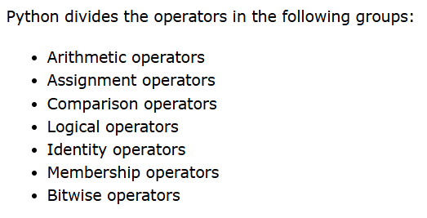
Python Operators:
link:https://www.w3schools.com/python/python_operators.asp

Slide 72
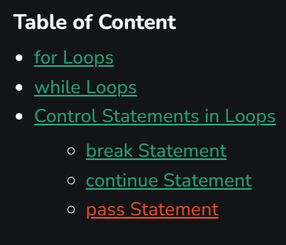
Python Iterators/loops:
link:https://www.geeksforgeeks.org/loops-and-control-statements-continue-break-and-pass-in-python/
Python supports two types of loops: for loops and while loops

Slide 73
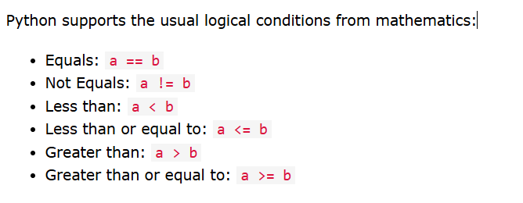
Python Conditions:

